Slide 1
UI Design Task
PPT Form
Development Environment
Layout Design

Slide 2
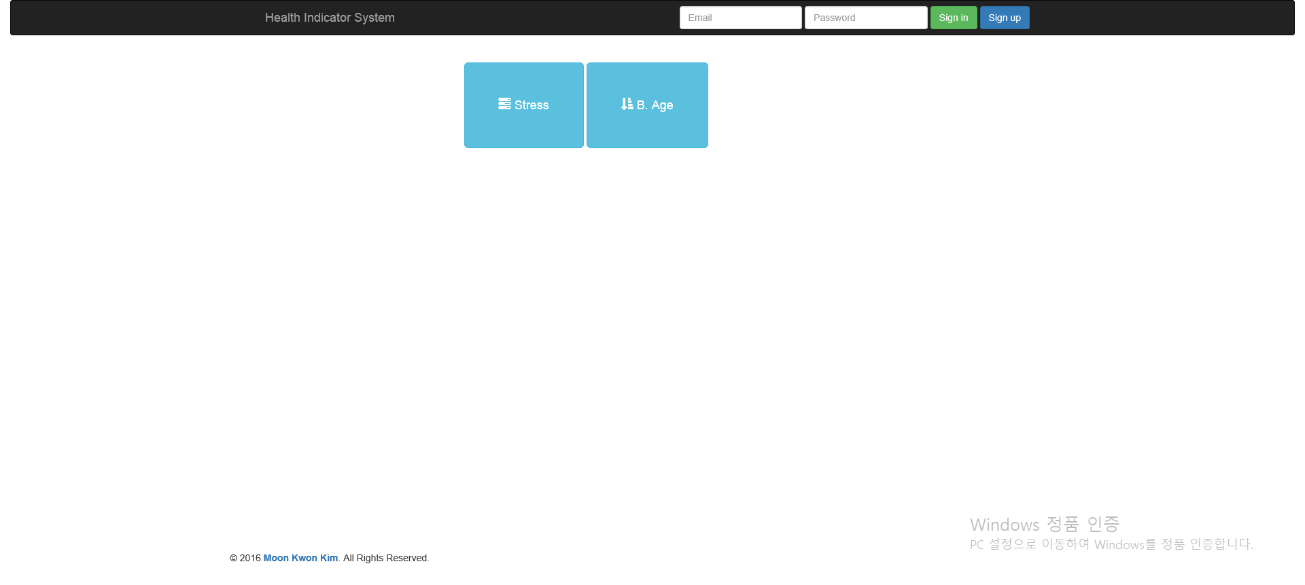
Index

Slide 3
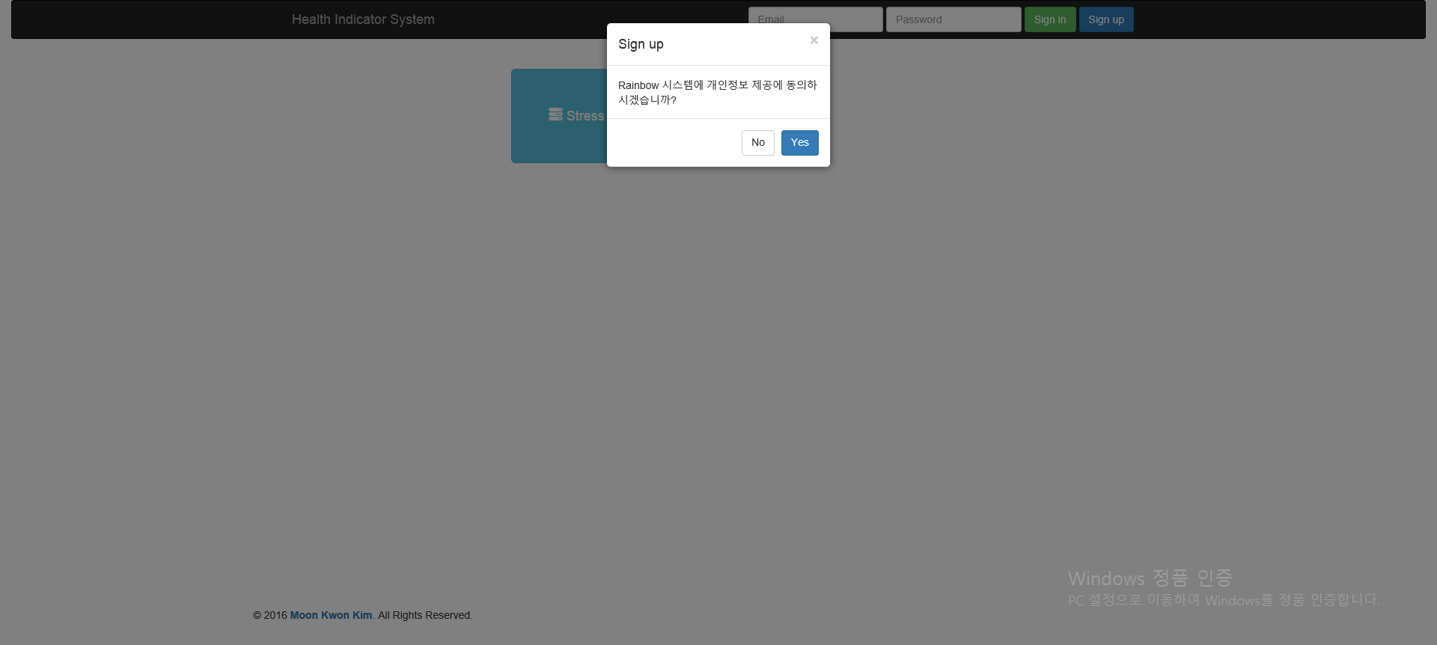
Sign up modal

Slide 4
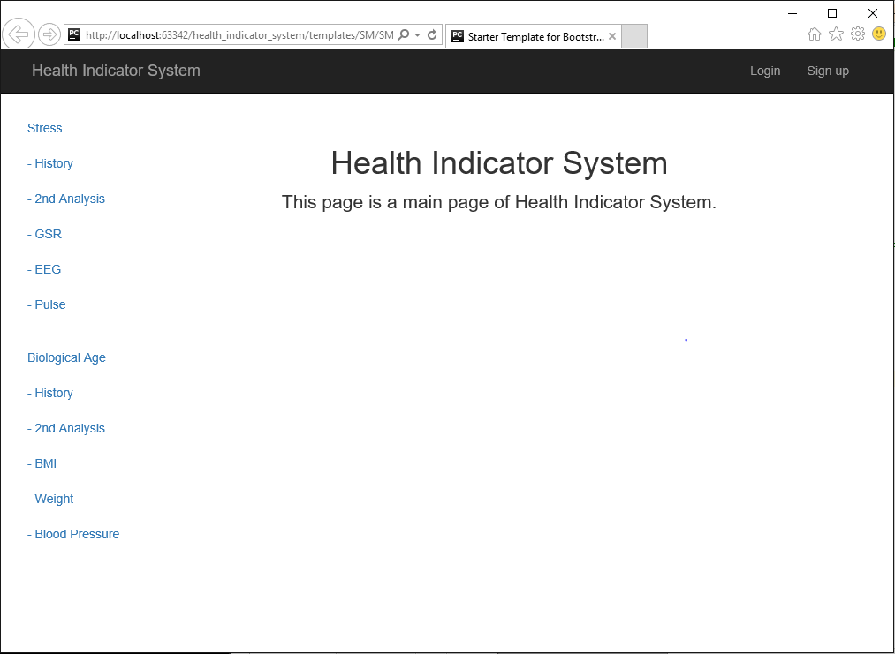
Stress & B.Age Page Layout

